Slide 1
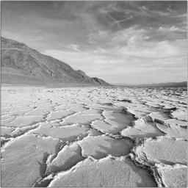
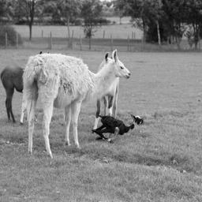
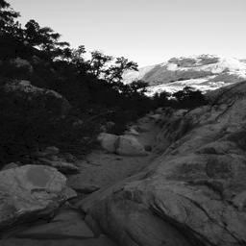
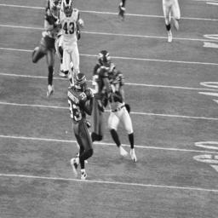
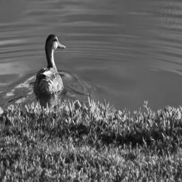
Colorizing Grayscale Images with Neural Networks
Goodwin Chen
December 13, 2018
Metis Career Day

Slide 2
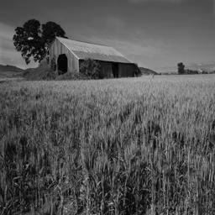
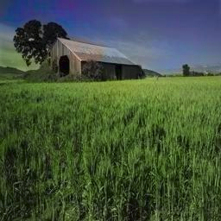
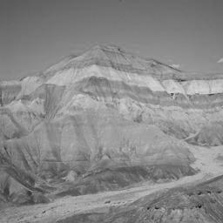
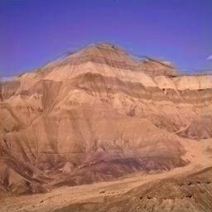

Slide 3
Motivation
People still color historical B&W photos using Photoshop
Useful in improving surveillance feeds

Slide 4
Dataset
Places365: http://places2.csail.mit.edu/download.html
256x256 resolution
5000 images per category
5 Categories of Images
Farm
Tundra
Mountain
Lake
Football Field

Slide 5




Technology
AWS Deep Learning instance with Nvidia K80 GPU
Keras
Scikit-Image

Slide 6
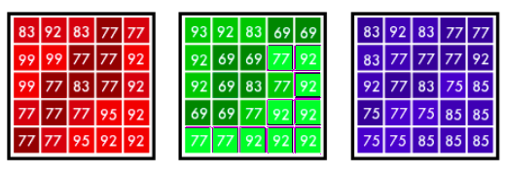
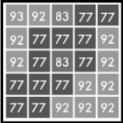
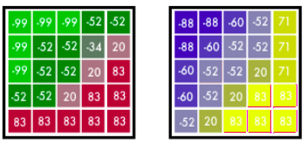
Methodology
Split each category into 4500 training images, 500 validation
Convert RGB -> Lab color space
R G B L a b
Use to predict

Slide 7
Model Architecture
4 Components
Encoder
Feature Extractor
Fusion Layer
Decoder

Slide 8
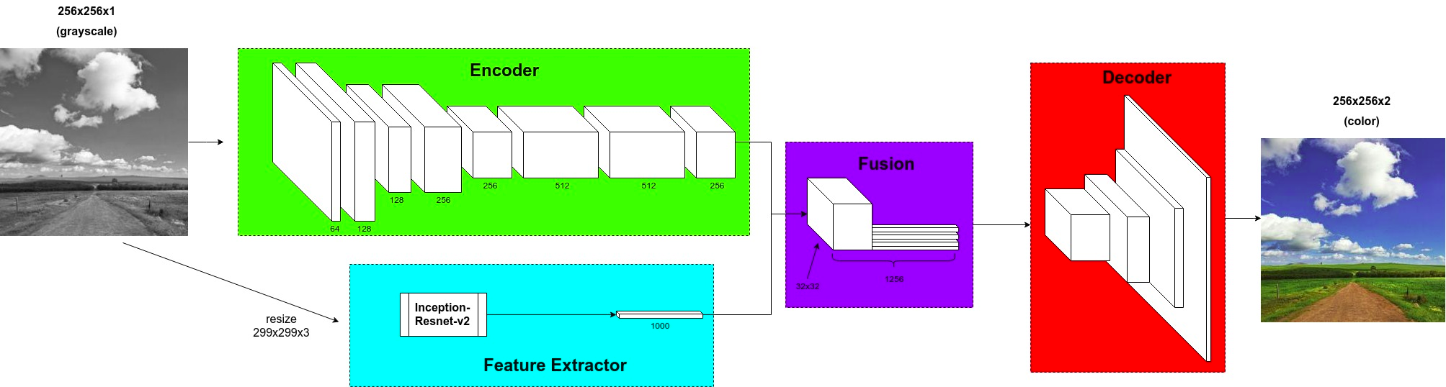
Inspired by VGG 16 architecture
Convolution with stride 2 instead of max pooling layer
Replicate Feature Extractor output and concatenate to Encoder output
Scale grayscale image to 299x299x3 as input to pre-trained Inception-Resnet-v2
Upsample from Fusion Layer to achieve original resolution
Regression on every pixel
Hyperbolic tangent activation function in final layer

Slide 9
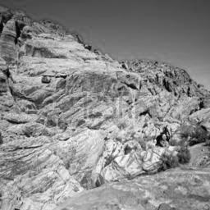
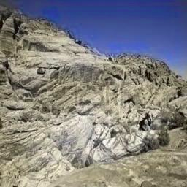
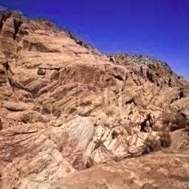
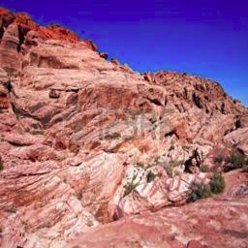
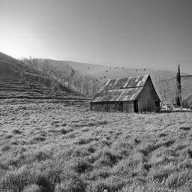
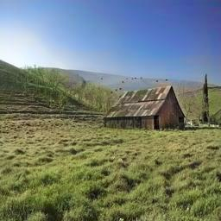
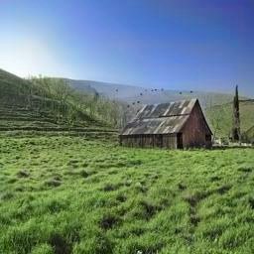
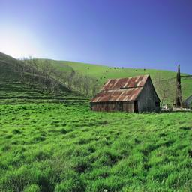
Results
grayscale
no fusion
with fusion
original

Slide 10
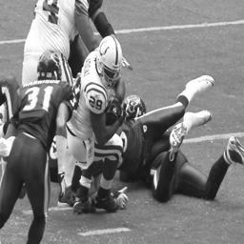
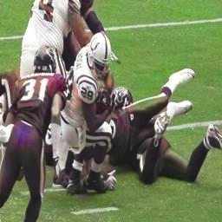
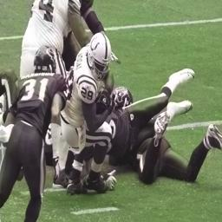
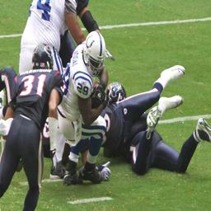
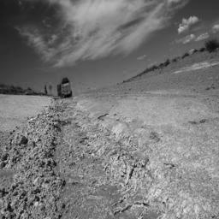
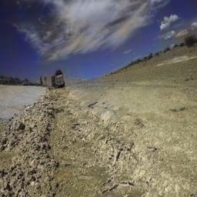
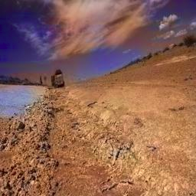
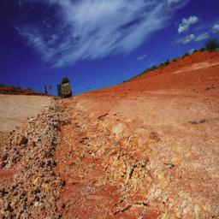
grayscale
no fusion
with fusion
original

Slide 11
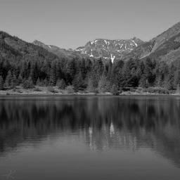
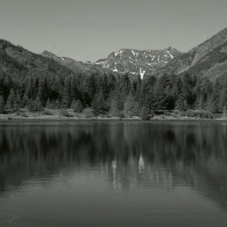
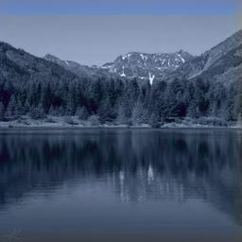
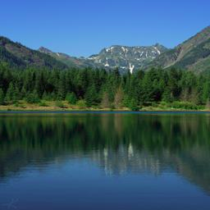
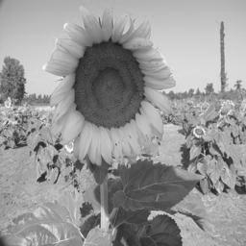
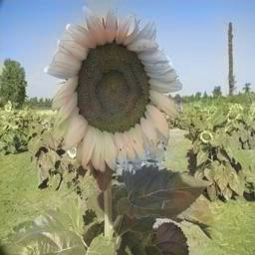
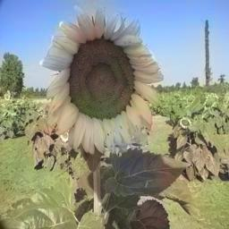
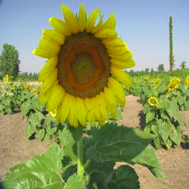
grayscale
no fusion
with fusion
original

Slide 12
Insights and Considerations
Bright colors are under-saturated
Consequence of regression loss function (e.g., flowers and clothes become gray vs either red or blue)
Consider weighted classification
Natural elements more well colored than specific objects
Consequence of small training set
Train on much larger and diverse dataset for better general results

Slide 13
Thank You!
E-mail
goodwinc@gmail.com
Github
https://github.com/goodwinc
LinkedIn
https://www.linkedin.com/in/goodwinchen/

